Slide 1
Part database
Precision Bends Team – Anthony Rainey,
Kaleb Gwyn,
Robert Cralley
Sponsor: Zach Wilkinson

Slide 2
Project Overview And Goals for Sprint 2
We are creating a product database app for Zach that…
Stores products along with their steps (the bends required to create the product).
Lets the user access these products and go through the steps to create the product.
Allows the user to store new products and steps to be used by others.
The goal for this sprint was to create an app that can do one step of the product process.
To compute the blade depth of a bend given some parameters.

Slide 3
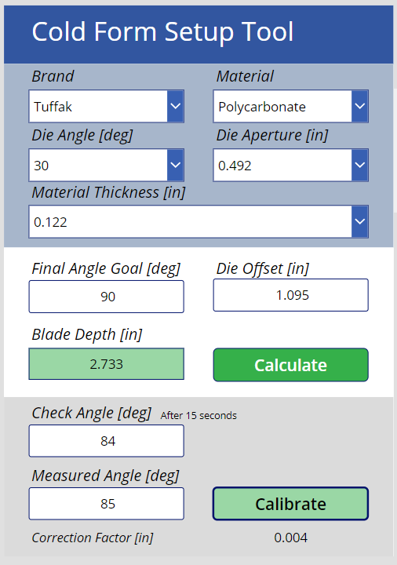
Sprint 2: Current Progress
We have recreated Zach’s previous app from scratch.
This gave us a deeper understanding on how both the process (of computing blade depth) and PowerApps worked.
This app computes the blade depth (the overall goal for each step) given the parameters. It also allows for calibrating the depth if its off the track for the goal (after 15 seconds).
When we implement products, it will take this idea and apply it over steps.

Slide 4
Demo of The App

Slide 5
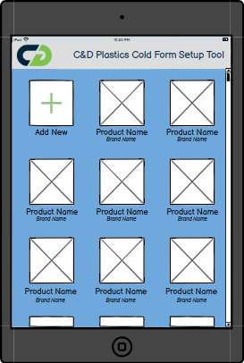
Sprint 3 GOALS
Implement Products into the app. Products are a series of steps of bends. The current app is used to compute the blade depth of 1 bend.
Create wireframes of a potential UI for such an app and get feedback from Zach.
Wireframe based on Zach’s Product Idea

